Slide 1

BS(SE)
PRESENTED BY:
Ramla Rahman 20949
Adila 20397
SUPERVISOR
Muhammad Abrar Khan
Online Assessment Proctoring System

Slide 2
Outline
Introduction
Related Work
Problem Statement
Proposed Solution
Methodology
Tools
References

Slide 3
Introduction
Online interviews have become widely adopted due to advancements in information and communication technologies, offering cost efficiency and accessibility. However, they raise concerns about fairness and integrity because candidates may use unauthorized resources or receive external assistance. To address these challenges, the Online Assessment Proctoring System (OAPS) is proposed as an automated monitoring solution.
Gaze Detection
Screen Tracking
Object Detection

Slide 4
Related Work
Maria Ahmad And Ghassan Mohammad. (2025):
Technique: Webcam-based face Detection
Key Focus: Detects head movement and face presence during online exams, Not interviews.
Limitation: Does not accurately detect gaze direction or screen switching, making it susceptible to students looking at other resources or screens.
S. Khan et al. (2021)
Technique: Object detection using deep learning
Key Focus: Detects unauthorized objects such as mobile phones and books.
Limitation: Lacks gaze monitoring and comprehensive behavioral analysis, potentially missing more subtle forms of cheating.
These examples highlight the need for a more robust system that can integrate various detection methods to enhance fairness and integrity in online assessments. OASPS Provides all in one solution for online interviews.

Slide 5
Problem Statement
Existing online interview systems lack an intelligent and unified mechanism to monitor candidate behavior effectively. There is no comprehensive solution that can accurately detect suspicious activities such as frequent gaze diversion, and unauthorized screen changes, leading to compromised interview integrity.

Slide 6
Proposed Solution
Eye Tracking with AI
To develop an AI-based gaze movement detection system to monitor candidate focus during online interviews. This is accomplished using MediaPipe FaceMesh (CV Framework) that provides model for Gaze Detection.
Unwanted Screen Changes
To detect unauthorized screen switching and application changes. It is​ accomplished using Browser Visibility API.
Object Detection
To detect Objects to prevent use of unauthorized rescources. It is accomplished using TensorFlow’s COCO SSD Model.

Slide 7
Methodology
The proposed system follows is developed using the Incremental software development model. The Incremental approach is adopted to ensure flexibility with continuous improvement throughout the development process.
OAPS Core Modules
CV Module (Gaze Monitoring)
Screen Monitoring Module
Object Detection Module
Frontend Dashboard

Slide 8
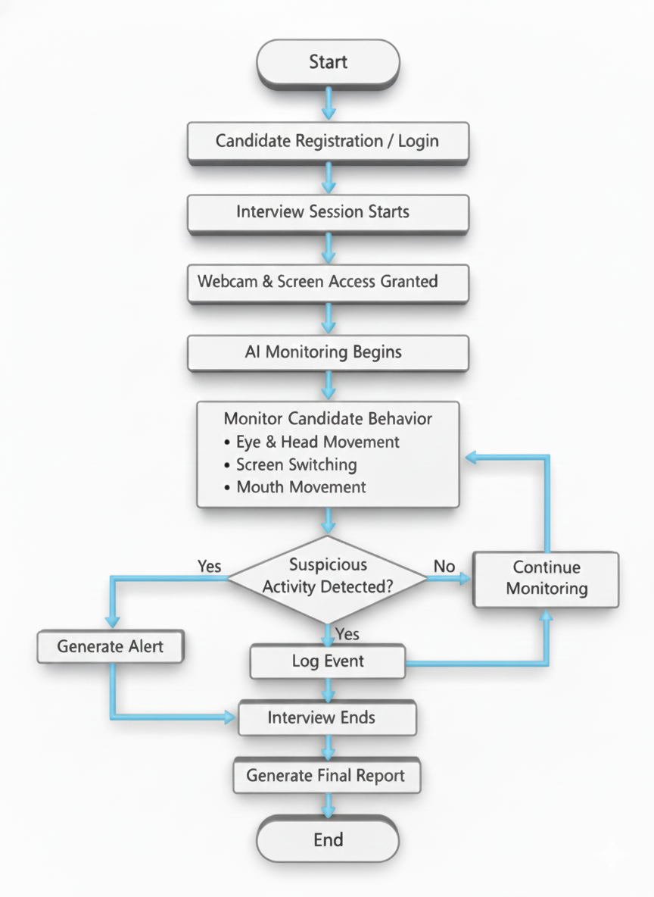
Figure 1.1

Slide 9
Tools
Gaze Monitoring:
MediaPipe Face Mesh (AI Powered CV Framework)
Screen Monitoring Module:
Browser Visibility API.
Object Detection Module:
TensorFlow’s COCO SSD Object Detection Model
Frontend Dashboard:
Web-based dashboard

Slide 10
References
Maria Ahmad And Ghassan Mohammad, “Advancements in Automated Cheating Detection Systems for Online and In-Person Examinations: A Comprehensive Review of Methods, Technologies, and Effectiveness”, IJMRAI, vol. 1, no. 2, pp. 131–142, Dec. 2025
N. Taskin, “Cheating and prevention strategies in online assessment,” Teach. Assess. Era Educ. 5.0, no. June, pp. 161–172, 2024.
K. Lee and M. Fanguy, “Online exam proctoring technologies: Educational innovation or deterioration? ,” Br. J. Educ. Technol., vol. 53, no. 3, pp. 475–490, 2022.
AC. Ozgen, M. U. Öztürk, O. Torun, J. Yang and M. Z. Alparslan, "Cheating Detection Pipeline for Online Interviews,"Signal Processing and Communications Applications Conference (SIU), pp. 1-4, June 2021.
I.Jegham, A. Ben Khalifa, I. Alouani, and M. Mahjoub, “Vision-based human action recognition: An overview and real-world challenges,” Digit. Investig., vol. 32, p. 200901, Mar. 2020.

Slide 11
Thanks

